Slide 1
Day 1 – Microservices Training
Nikhil Damle
Amar Durga Tatyasaheb Patil
November – December 2021

Slide 2
Introduction to Microservices
What is Microservices?
Monolith Architecture vs SOA vs Microservices
Twelve Factor Principles for Application Development
Overview of Microservice Concepts and Characteristics
Microservice Based Architecture
Benefits and Limitations of Microservices
REST Architecture Principles

Slide 3
What is microservices?
“The microservice architectural style is an approach to developing a single application as a suite of small services, each running in its own process and communicating with lightweight mechanisms.”
- James Lewis and Martin Fowler, Thoughtworks
“Microservices are small, autonomous services that work together.”
Sam Newman, Thoughtworks
Microservices are cloud-native approach to building applications from "loosely coupled and independently deployable smaller components, or services" that:
Have their own stack, Use REST APIs and other forms of communication to connect to other services; and are sorted by business capability and separated into "need-to-know" chunks via bounded context.
- IBM

Slide 4
Why should microservices matter to us
89%of technology leaders agree that companies that are not able to effectively support microservices will be less able to compete in the future.
The primary reasons cited for adopting microservices are
improvements to security (56%),
increased development speed (55%),
increased speed of integrating new technologies (53%),
improved infrastructure flexibility (53%) and
improved collaboration across teams (46%)
Availability (75%), security (74%), performance (65%) and scalability (64%) are given highest importance.
Increased demand for frequent updates to the applications, In response to user demands for interactive, rich and dynamic experiences on various platforms, microservices can support the frequency demand. It also goes well with the need of scalability.

Slide 5
Micro
Big or small
No universal measure
“Does one thing”
Scope of functionalities
Identify sub-domains

Slide 6
Benefits of Microservices
Small Services
Can be owned by a team
Easier to understand
Can be rewritten
Technology Choice
Adopt new technology
Use the right tool
Standardize where it
makes sense
Agility
Adapt rapidly
Easier reuse
Individual Deployment
Lower risk
Minimize downtime
Frequent updates
Scaling
Scale services individually
Cost-effective

Slide 7
We can summarize it as
Microservices are an app design architecture with a philosophy based on building independent components that all connect via API (HTTP, Thrift or REST) to reduce complexity, increase scalability, and allow applications to be distributed with more ease than traditional monolithic-style program architecture.
Small Services
Technology Choice
Individual Deployment
Scaling
Agility

Slide 8
Monolith vs SOA vs Microservices
Creating a new product is all about risk and choosing the right architecture is an essential step toward success.
Monolithic architecture
”Monolith is an ancient word referring to a huge single block of stone. Though this term is used broadly today, the image remains the same across fields”
A monolithic pattern refers to a single indivisible unit. The concept of monolithic software lies in different components of an application being combined into a single program on a single platform.
Usually, a monolithic app consists of a database, client-side user interface, and server-side application. All the software’s parts are unified and all its functions are managed in one place.

Slide 9
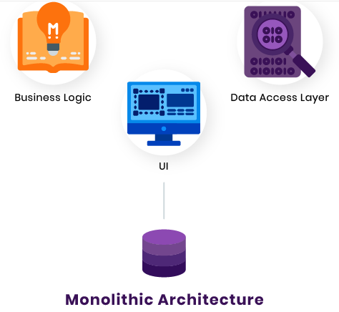
Pros | Cons
Simpler development and deployment | Codebase gets cumbersome over time
Fewer cross-cutting concerns | Difficult to adopt new technologies
Better performance | Limited agility

Slide 10
Service-oriented Architecture (SOA)
A service-oriented architecture (SOA) is a software architecture style that refers to an application composed of discrete and loosely coupled software agents that perform a required function.
SOA has two main roles
A service provider
A service consumer
Both of these roles can be played by a software agent.
The concept of SOA lies in the following - an application can be designed and built in a way that its modules are integrated seamlessly and can be easily reused.
Pros | Cons
Reusability of services | Complex management
Better maintainability | High investment costs
Higher reliability | Extra overload
Parallel development

Slide 11
Microservice Architecture
Microservice is a type of service-oriented software architecture that focuses on building a series of autonomous components that make up an app. Unlike monolithic apps built as a single indivisible unit, microservice apps consist of multiple independent components that are glued together with APIs.
The microservices approach focuses mainly on business priorities and capabilities, whereas the monolithic approach is organized around technology layers, UIs, and databases. The microservices approach has become a trend in recent years as more and more enterprises become agile and move toward DevOps.
Microservices are important simply because they add unique value in a way of simplification of complexity in systems. By breaking apart your system or application into many smaller parts, you show ways of reducing duplication, increasing cohesion and lowering your coupling between parts, thus making your overall system parts easier to understand, more scalable, and easier to change.
Lucas Krause, author of Microservices

Slide 12
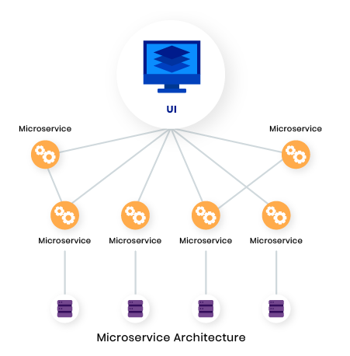
Pros | Cons
Easy to develop, test, and deploy | Complexity
Increased agility | Security concerns
Ability to scale horizontally | Different programming languages

Slide 13
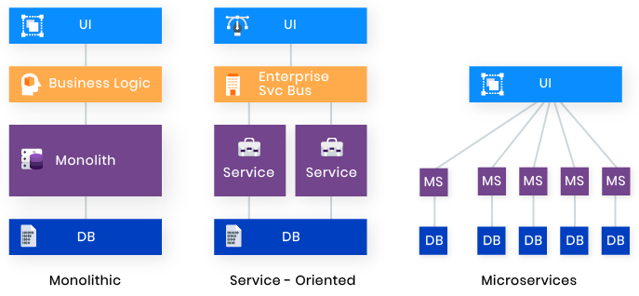
The Bottom Line
Microservices are good, but not for all types of apps.
This pattern works great for evolving applications and complex systems.
Choosing a microservices architecture when you have multiple experienced teams and when the app is complex enough to break it into services.
When an application is large and needs to be flexible and scalable, microservices are beneficial.
All three software architectures to define the differences between them visually.

Slide 14
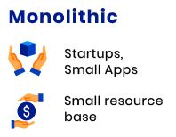
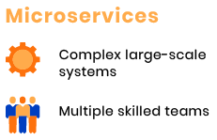
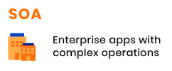
Monolithic apps consist of interdependent, indivisible units and feature very low development speed.
SOA is broken into smaller, moderately coupled services, and features slow development.
Microservices are very small, loosely coupled independent services and feature rapid continuous development.

Slide 15
Twelve Factor Principles for Application Development
In the modern era, software is commonly delivered as a service: called web apps, or software-as-a-service. The twelve-factor app is a methodology for building software-as-a-service apps that:
Use declarative formats for setup automation, to minimize time and cost for new developers joining the project;
Have a clean contract with the underlying operating system, offering maximum portability between execution environments;
Are suitable for deployment on modern cloud platforms, obviating the need for servers and systems administration;
Minimize divergence between development and production, enabling continuous deployment for maximum agility;
And can scale up without significant changes to tooling, architecture, or development practices.
The twelve-factor methodology can be applied to apps written in any programming language, and which use any combination of backing services (database, queue, memory cache, etc).

Slide 16
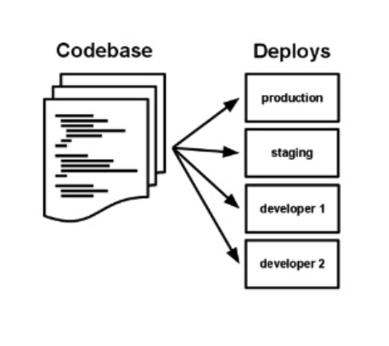
1. Codebase
“One codebase tracked in revision control; many deploys.”
Dedicate smaller teams to individual applications or microservices.
Following the discipline of single repository for an application forces the teams to analyze the seams of their application and identify potential monoliths that should be split off into microservices.
Use a single source code repository for a single application (1:1 relation). Deployment stages are different tags/branches i.e. use a central git repo (external GitHub /GitHub Enterprise also suitable).

Slide 17
2. Dependencies
“Explicitly declare and isolate dependencies”
A cloud-native application does not rely on the pre-existence of dependencies in a deployment target. Developer Tools declare and isolate dependencies.
Maven and Gradle for Java.
Each microservice has its own dependencies declared (e.g. pom.xml).
3. Config
“Store config in the environment”
Changing config should not need to repackage your application
Use Kubernetes config maps and secrets (rather than environment variables) for container services
Use Micro Profile Config to inject the config properties into the microservices
App
Password=blah

Slide 18
4. Backing Services
“Treat backing services as attached resources”
My SQL
Application
Twitter
Amazon S3
5. Build, Release, Runs
“Strictly separate build and run stages”
Azure
Visual Studio Team Services (VSTS) (includes git)
Web App for Containers feature of Azure App Service
Source code is used in the build stage. Configuration data is added to define a release stage that can be deployed. Any changes in code or config will result in a new build/release.
Needs to be considered in CI pipeline.
AWS
AWS CodeBuild
AWS CodeDeploy
AWS CodePipeline (not yet integrated with EKS)
IBM
UrbanCode Deploy
IBM Cloud Continuous Delivery Service

Slide 19

6. Processes
"Execute the app as one or more stateless processes"
Stateless and share-nothing
Rest API
7. Port Binding
“Export services via port binding”
Applications are fully self-contained and expose services only through ports. Port assignment is done by the execution environment
Ingress/service definition of k8s manages mapping of ports
Use MP Config to inject ports to microservices for chain-up invocations.
Port = 80
@Inject @ConfigProperty(name=”port”, defaultValue=“9080”)

Slide 20
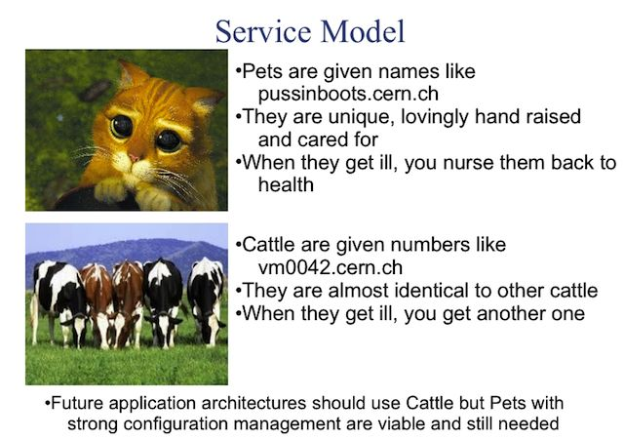
8. Concurrency
“Scale out via the process model”
Applications use processes independent from each other to scale out (allowing for load balancing)
To be considered in application design
Cloud autoscaling services: [auto]scaling built into k8s
Build microservices
9. Disposability
“Maximize robustness with fast start-up and graceful shutdown”
Processes start up fast.
Processes shut down gracefully when requested.
Processes are robust against sudden death
Use Micro Profile Fault Tolerance to make it resilient

Slide 21
10. Dev/Prod Parity
“Keep development, staging, and production as similar as possible”
Development and production are as close as possible (in terms of code, people, and environments)
Can use helm to deploy in repeatable manner
Use (name)spaces for isolation of similar setups
11. Logs
“Treat logs as event streams”
App writes all logs to stdout
Use a structured output for meaningful logs suitable for analysis. Execution environment handles routing and analysis infrastructure

Slide 22
12. Admin Processes
“Run admin/management tasks as one-off processes”
Tooling: standard k8s tooling like “kubectl exec” or Kubernetes Jobs
Also to be considered in solution/application design
For example, if an application needs to migrate data into a database, place this task into a separate component instead of adding it to the main application code at startup

Slide 23
Microservice Characteristics
Componentization via Services
(Team) Organized around Business Capabilities
Products not Projects
Smart endpoints and dumb pipes
Decentralized Governance
Decentralized Data Management
Infrastructure Automation
Design for failure
Evolutionary Design

Slide 24
Componentization via Services
The last couple of decades we've seen considerable progress with large compendiums of common libraries that are part of most language platforms.
When talking about components we run into the difficult definition of what makes a component. Our definition is that a component is a unit of software that is independently replaceable and upgradeable.
Microservice architectures will use libraries, but their primary way of componentizing their own software is by breaking down into services.
One main reason for using services as components (rather than libraries) is that services are independently deployable.
Another consequence of using services as components is a more explicit component interface. Most languages do not have a good mechanism for defining an explicit Published Interface.
A service may consist of multiple processes that will always be developed and deployed together, such as an application process and a database that's only used by that service.

Slide 25
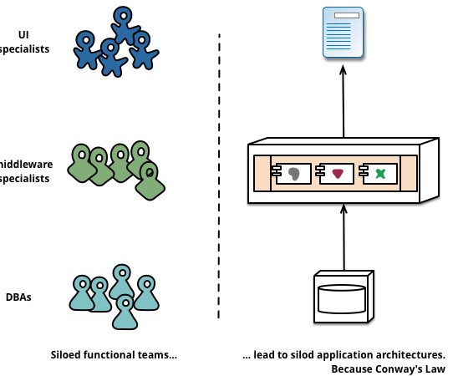
2. (Team) Organized around Business Capabilities
When looking to split a large application into parts, often management focuses on the technology layer, leading to UI teams, server-side logic teams, and database teams. When teams are separated along these lines, even simple changes can lead to a cross-team project taking time and budgetary approval. A smart team will optimise around this and plump for the lesser of two evils - just force the logic into whichever application they have access to. Logic everywhere in other words. This is an example of Conway's Law in action.
Any organization that designs a system (defined broadly) will produce a design whose structure is a copy of the organization's communication structure -- Melvin Conway, 1968

Slide 26
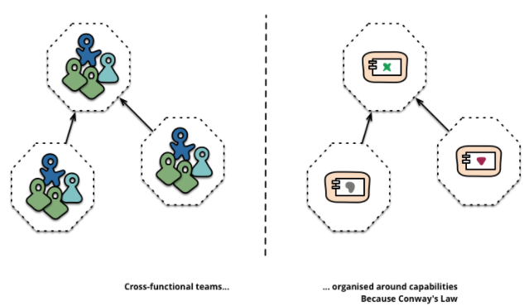
The microservice approach to division is different, splitting up into services organized around business capability. Such services take a broad-stack implementation of software for that business area, including user-interface, persistant storage, and any external collaborations. Consequently the teams are cross-functional, including the full range of skills required for the development: user-experience, database, and project management.

Slide 27
3. Products not Projects
Most application development efforts that we see use a project model: where the aim is to deliver some piece of software which is then considered to be completed. On completion the software is handed over to a maintenance organization and the project team that built it is disbanded.
Microservice proponents tend to avoid this model, preferring instead the notion that a team should own a product over its full lifetime. A common inspiration for this is Amazon's notion of "you build, you run it" where a development team takes full responsibility for the software in production. This brings developers into day-to-day contact with how their software behaves in production and increases contact with their users, as they have to take on at least some of the support burden
There's no reason why this same approach can't be taken with monolithic applications, but the smaller granularity of services can make it easier to create the personal relationships between service developers and their users

Slide 28
4. Smart endpoints and dumb pipes
The microservice community favours an alternative approach: smart endpoints and dumb pipes. Applications built from microservices aim to be as decoupled and as cohesive as possible - they own their own domain logic and act more as filters in the classical Unix sense - receiving a request, applying logic as appropriate and producing a response.
The two protocols used most commonly are HTTP request-response with resource API's and lightweight messaging
Microservice teams use the principles and protocols that the world wide web (and to a large extent, Unix) is built on.
The second approach in common use is messaging over a lightweight message bus. The infrastructure chosen is typically dumb (dumb as in acts as a message router only) - simple implementations such as RabbitMQ or ZeroMQ don't do much more than provide a reliable asynchronous fabric - the smarts still live in the end points that are producing and consuming messages in the services.

Slide 29
5. Decentralized Governance
One of the consequences of centralised governance is the tendency to standardise on single technology platforms.
Experience shows that this approach is constricting - not every problem is a nail and not every solution a hammer
We prefer using the right tool for the job and while monolithic applications can take advantage of different languages to a certain extent, it isn't that common.
Teams building microservices prefer a different approach to standards too. Rather than use a set of defined standards written down somewhere on paper they prefer the idea of producing useful tools that other developers can use to solve similar problems to the ones they are facing.
Netflix is a good example of an organisation that follows this philosophy
For the microservice community, overheads are particularly unattractive
Perhaps the apogee of decentralised governance is the build it / run it ethos popularised by Amazon.

Slide 30
6. Decentralized Data Management
Decentralization of data management presents in a number of different ways
At the most abstract level, it means that the conceptual model of the world will differ between systems. This is a common issue when integrating across a large enterprise, the sales view of a customer will differ from the support view.
A useful way of thinking about this is the Domain-Driven Design notion of Bounded Context. DDD divides a complex domain up into multiple bounded contexts and maps out the relationships between them.
As well as decentralizing decisions about conceptual models, microservices also decentralize data storage decisions.
While monolithic applications prefer a single logical database for persistant data. Microservices prefer letting each service manage its own database, either different instances of the same database technology, or entirely different database systems - an approach called Polyglot Persistence.

Slide 31
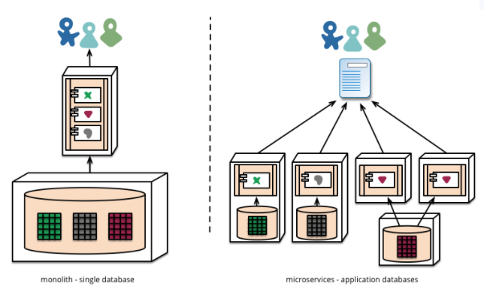
Using transactions like this helps with consistency, but imposes significant temporal coupling, which is problematic across multiple services.
Distributed transactions are notoriously difficult to implement and as a consequence microservice architectures emphasize transactionless coordination between services.
Choosing to manage inconsistencies in this way is a new challenge for many development teams, but it is one that often matches business practice

Slide 32
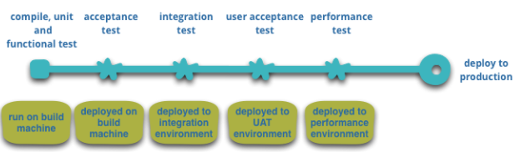
7. Infrastructure Automation
Infrastructure automation techniques have evolved enormously over the last few years - the evolution of the cloud and AWS in particular has reduced the operational complexity of building, deploying and operating microservices.
Many of the products or systems being build with microservices are being built by teams with extensive experience of Continuous Delivery and it's precursor, Continuous Integration.

Slide 33
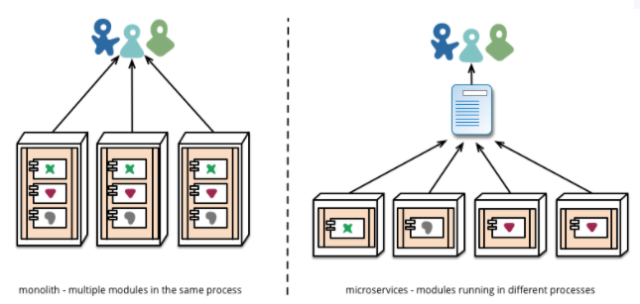
Another area where we see teams using extensive infrastructure automation is when managing microservices in production.
In contrast to our assertion above that as long as deployment is boring there isn't that much difference between monoliths and microservices, the operational landscape for each can be strikingly different.

Slide 34
8. Design for failure
A consequence of using services as components, is that applications need to be designed so that they can tolerate the failure of services. Any service call could fail due to unavailability of the supplier.
Netflix's Simian Army induces failures of services and even datacenters during the working day to test both the application's resilience and monitoring.
Since services can fail at any time, it's important to be able to detect the failures quickly and, if possible, automatically restore service. Microservice applications put a lot of emphasis on real-time monitoring of the application, checking both architectural elements (how many requests per second is the database getting) and business relevant metrics (such as how many orders per minute are received).
Microservice teams would expect to see sophisticated monitoring and logging setups for each individual service such as dashboards showing up/down status and a variety of operational and business relevant metrics. Details on circuit breaker status, current throughput and latency are other examples we often encounter in the wild.

Slide 35
9. Evolutionary Design
Microservice practitioners, usually have come from an evolutionary design background and see service decomposition as a further tool to enable application developers to control changes in their application without slowing down change
Netflix is a good example of an application that was designed and built as a monolith, but has been evolving in a microservice direction. They prefer to add new features by building microservices that use the monolith's API.
Putting components into services adds an opportunity for more granular release planning. With a monolith any changes require a full build and deployment of the entire application. With microservices, however, you only need to redeploy the service(s) you modified. This can simplify and speed up the release process.
The traditional integration approach is to try to deal with this problem using versioning, but the preference in the microservice world is to only use versioning as a last resort. We can avoid a lot of versioning by designing services to be as tolerant as possible to changes in their suppliers

Slide 36
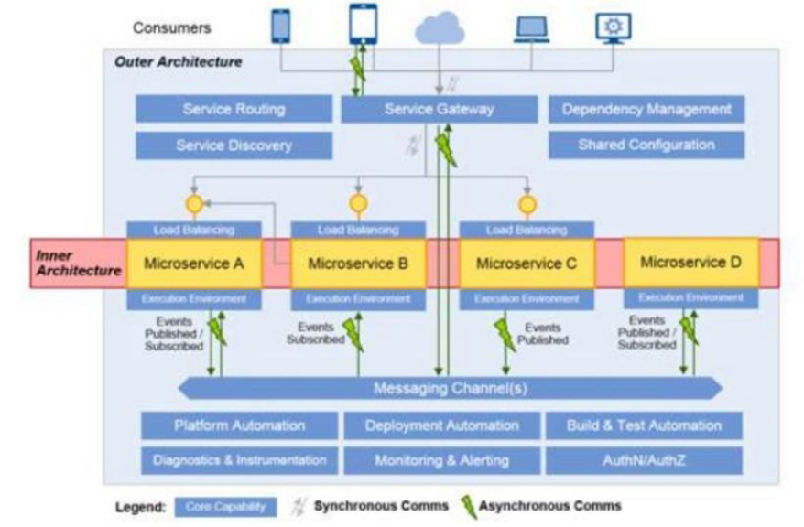
Microservice Based Architecture

Slide 37
Benefits of Microservices
A microservices application architecture involves breaking a monolithic application into its component functions or services.
After identifying the individual services, developers refactor the monolith so that each service runs autonomously as a separate “microservice”.
Then, they loosely connect these microservices via APIs to form the larger microservices-based application.
The resulting microservices-based application offers a pluggable architectural style. This style enables fast and cost-efficient upgrades.
This makes it easier and less expensive to scale one part of the application.
You can do this without affecting the rest of the application.

Slide 38
Small Services
Can be owned by a team
Easier to understand
Can be rewritten
Manageable code

Slide 39
Programming Language and
Technology Agnostic
When creating a microservices-based application, developers can connect microservices programmed in any language. They can also connect microservices running on any platform. This offers more flexibility to use the programming languages and technologies that best fit the needs of the project and the skillsets of your team.
Teams can choose different technologies for implementing their services. I found that this is particularly useful when adopting a new technology.
An example was the introduction of the Scala language, which is a better option for developing low latency and high throughput applications. A team was able to use Scala in their own service without impacting other services, which used C++. Such a change would not be technically easy if it were part of a monolithic application.
Lastly, the users of a cloud-based microservices application can access the application from any internet-connected device – regardless of whether it’s a PC, Mac, Android, or iOS platform.

Slide 40
Agility
Most important advantage of microservices “would be agility, the ability to iterate on a small, focused piece of functionality quickly, and to see results.”
The pluggability of a microservices application architecture allows for easier and faster application development and upgrades.
Developers can quickly build or change a microservice, then plug it into the architecture with less risk of coding conflicts and service outages.
Moreover, due to the independence of each microservice, teams don’t have to worry about coding conflicts, and they don’t have to wait for slower-moving projects before launching their part of the application.

Slide 41
Individual Deployment
Microservices also support the CI/CD )Continuous Integration, Continuous Delivery, Continuous Deployment) development philosophy. This means that you quickly deploy the core microservices of an application – as a minimum viable product (MVP)
Continuously update the product over time as you complete additional microservices.
It also means that you can respond to security threats and add new technologies as they appear. The result for the user is a “future proof” product that’s constantly evolving with the times.

Slide 42
Scalability
Scale services individually
The capacity of each microservice to run autonomously makes it relatively easy to add, remove, update, and scale individual microservices.
This can be done without disrupting the other microservices that comprise the application. When demand increases, you only need to upgrade or divert more resources to the microservice affected by the increasing demands.
Cost-effective
By only scaling the services that need it, for as long as they need it, enterprises can save a lot of money on the cost of cloud server resources.
Netflix is an excellent example of using microservices to overcome scaling challenges.
In late 2008, Netflix experienced a three-day service failure caused by increasing demands on its servers. After struggling to scale to these demands, Netflix decided to refactor its monolithic application into a horizontally-scalable, distributed system of microservices running on Amazon AWS cloud servers.

Slide 43
Support for Two-Pizza
Development Teams
Amazon, the first pioneer of microservices, used this architectural style to support the “two-pizza development team rule.” Teams are kept small enough to be fed by two pizzas.
Amazon claims that the two-pizza rule:
Improves work efficiency
Makes teams easier to manage
Achieves goals faster
Results in greater focus
Produces higher quality products
By assigning ownership of each microservice to a small team, the individual teams can work more closely, stay on the same page, and be more focused and accountable for their work. They get to know each other better, they form relationships, trust, and motivation

Slide 44
Limitations of Microservices
The main negative of microservices is the complexity that any distributed system has
Communication between services
is complex :
Since everything is now an independent service, you have to carefully handle requests traveling between your modules. In one such scenario, developers may be forced to write extra code to avoid disruption. Over time, complications will arise when remote calls experience latency.
Large vs small product companies: Microservices are great for large companies, but can be slower to implement and too complicated for small companies who need to create and iterate quickly, and don’t want to get bogged down in complex orchestration.
More services equals more resources”
Multiple databases and transaction management can be painful.
Deployment challengers: The product may need coordination among multiple services, which may not be as straightforward as deploying a WAR in a container.
Global testing is difficult :
Testing a microservices-based application can be cumbersome. In a monolithic approach, we would just need to launch our WAR on an application server and ensure its connectivity with the underlying database. With microservices, each dependent service needs to be confirmed before testing can occur.
Debugging problems
can be harder :
Each service has its own set of logs to go through. Log, logs, and more logs.

Slide 45
REST Architecture Principles
REST stands for Representational State Transfer, a term coined by Roy Fielding in 2000. It is an architecture style for designing loosely coupled applications over HTTP, that is often used in the development of web services. REST does not enforce any rule regarding how it should be implemented at lower level, it just put high level design guidelines and leave you to think of your own implementation.
REST defines 6 architectural constraints which make any web service – a true RESTful API.
Uniform interface
Client–server
Stateless
Cacheable
Layered system
Code on demand (optional)

Slide 46
Uniform Interface
As the constraint name itself applies, you MUST decide APIs interface for resources inside the system which are exposed to API consumers and follow religiously. A resource in the system should have only one logical URI, and that should provide a way to fetch related or additional data. It’s always better to synonymize a resource with a web page.
Any single resource should not be too large and contain each and everything in its representation. Whenever relevant, a resource should contain links (HATEOAS) pointing to relative URIs to fetch related information.
Also, the resource representations across the system should follow specific guidelines such as naming conventions, link formats, or data format (XML or/and JSON).
All resources should be accessible through a common approach such as HTTP GET and similarly modified using a consistent approach.
“Once a developer becomes familiar with one of your APIs, he should be able to follow a similar approach for other APIs.”

Slide 47
Client – Server
This constraint essentially means that client application and server application MUST be able to evolve separately without any dependency on each other. A client should know only resource URIs, and that’s all. Today, this is standard practice in web development, so nothing fancy is required from your side. Keep it simple.
“Servers and clients may also be replaced and developed independently, as long as the interface between them is not altered”
Stateless
Roy fielding got inspiration from HTTP, so it reflects in this constraint. Make all client-server interactions stateless. The server will not store anything about the latest HTTP request the client made. It will treat every request as new. No session, no history.
If the client application needs to be a stateful application for the end-user, where user logs in once and do other authorized operations after that, then each request from the client should contain all the information necessary to service the request – including authentication and authorization details.
“No client context shall be stored on the server between requests. The client is responsible for managing the state of the application”

Slide 48
Cacheable
In today’s world, the caching of data and responses is of utmost importance wherever they are applicable/possible. The webpage you are reading here is also a cached version of the HTML page. Caching brings performance improvement for the client-side and better scope for scalability for a server because the load has reduced.
In REST, caching shall be applied to resources when applicable, and then these resources MUST declare themselves cacheable. Caching can be implemented on the server or client-side.
“Well-managed caching partially or completely eliminates some client-server interactions, further improving scalability and performance”
Layered System
REST allows you to use a layered system architecture where you deploy the APIs on server A, and store data on server B and authenticate requests in Server C, for example. A client cannot ordinarily tell whether it is connected directly to the end server or an intermediary along the way.

Slide 49
Code on demand (optional)
In today’s world, Well, this constraint is optional. Most of the time, you will be sending the static representations of resources in the form of XML or JSON. But when you need to, you are free to return executable code to support a part of your application, e.g., clients may call your API to get a UI widget rendering code. It is permitted.
“All the above constraints help you build a truly RESTful API, and you should follow them. Still, at times, you may find yourself violating one or two constraints. Do not worry; you are still making a RESTful API – but not “truly RESTful”
Notice that all the above constraints are most closely related to WWW (the web). Using RESTful APIs, you can do the same thing with your web services what you do to web pages.

Slide 50
Microservices Application
Example

